Slide 1
IGGI Game Design Part II Monte Carlo Tree Search
Diego Perez-Liebana

Slide 2
Contents
Monte Carlo Tree Search
A case study: PTSP

Slide 3
Contents
Monte Carlo Tree Search
A case study: PTSP

Slide 4
Simulation-based Search
Forward search algorithms select the next action to take by looking ahead the states found after applying certain available actions.
They need a model of the game to simulate these actions.
Given a current state S_{t} and an action A_{t} applied from S_{t}, the forward model will provide the next state s_{t+1}
S_{t,} A_{t} S_{t+1}
Forward
Model

Slide 5

Simulation-based Search
Simulate episodes of experience from the current state using the model:
Until reaching a terminal state (game end) or a predefined depth (i.e. the end of a chess game may be many plies ahead!)

Slide 6
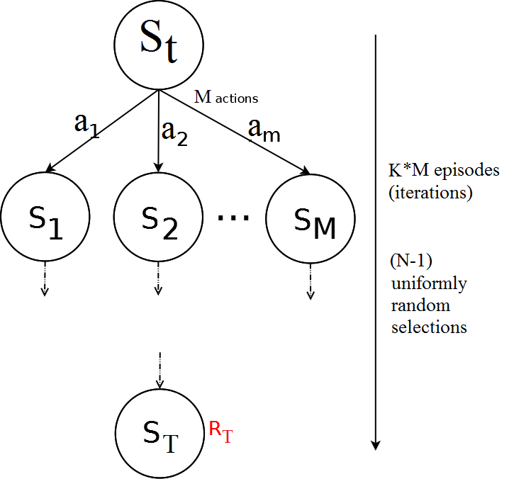
Flat Monte Carlo
Given a model M and a simulation policy π, that picks actions uniformly at random:
Iteratively, apply K episodes (iterations) from each one of the M actions.
Select the action at each step uniformly at random, random until reaching terminal state or pre-defined depth.
Compute the average reward for each action.
Pick the action that leads to the highest average reward after K*M episodes.

Slide 7
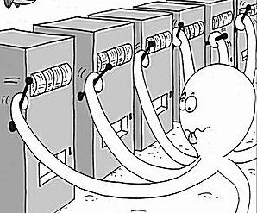
Regret and Bounds
Is picking actions at random the best strategy?
Should we give to all actions the same amount of trials?
We are treating all actions as equal, although ones might be clearly better than others. But then, what is the best policy?
Balance between exploration and exploitation.
Exploitation: Make the best decision based on current information.
Exploration: Gather more information about the environment. This is, not choosing the best action found so far.
The objective is gather enough information to make the best overall decision.
N-armed Bandit Problem

Slide 8
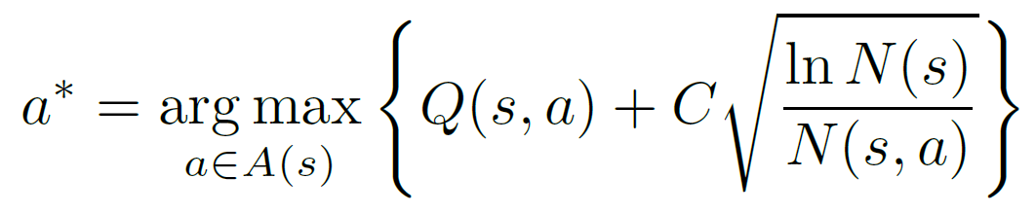
UCB1
UCB1 (typically found in the literature in this form):
Q(s,a): Q-value of action a from state s (average of rewards after taking action a from state s).
N(s): Times the state s has been visited.
N(s,a): Times the action a has been picked from state s.
C: Balances between exploitation (Q term) and exploration (square root).
Value of C is application dependent.
Example: single player games with rewards in [0,1]: C = SQRT(2)

Slide 9
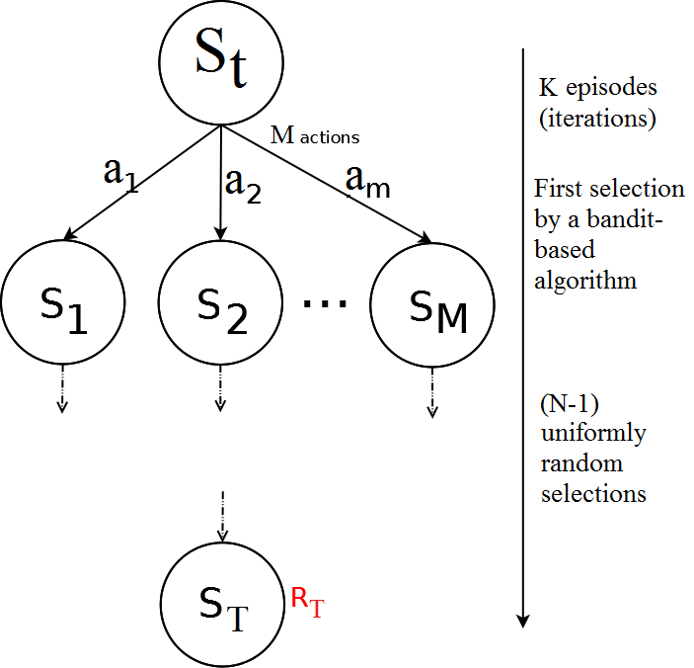
Flat UCB
Given a model M and a bandit-based simulation policy π, that picks actions uniformly at random:
Note that the policy π improves at each episode!
Iteratively, apply K episodes (iterations).
Select the first action from S_{t} with a bandit-based policy (UCB1, or any other UCB).
Pick actions uniformly at random until reaching terminal state or pre-defined depth.
Compute the average reward for each action.
Pick the action that leads to the highest average reward after K episodes.

Slide 10
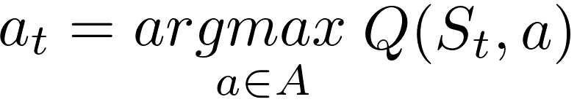
Building a Search Tree
Given a model M and the current simulation policy π:
For each action a ∈ A:
Simulate K episodes from current state S_{t}
Each episode is run until reaching a terminal state S_{T}, with an associated reward R_{T} (or a number of moves is reached).
Compute Mean/Expected Return for each action (Monte Carlo evaluation)
Build a search tree containing visited states and actions
Recommendation Policy:
Select action to apply with highest Expected Return
(greedy recommendation policy)

Slide 11
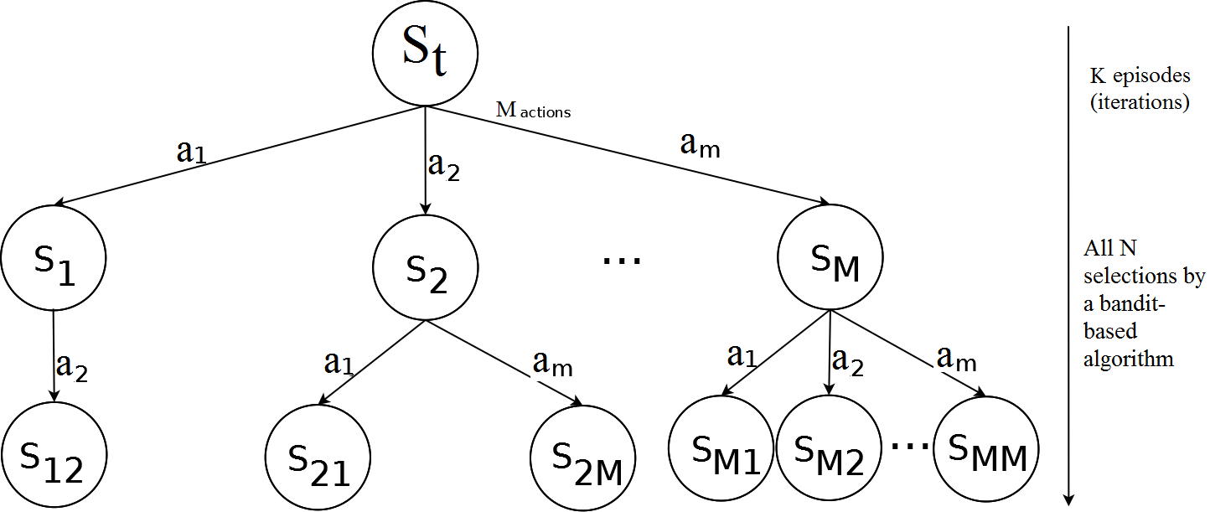
Simulation-Based Search: Building a tree
Applying and UCB policy, adding a node (state) at each iteration, the tree grows asymmetrically, towards the most promising parts of the search space.
This is, however, limited by how far can we look ahead into the future (less than with random roll-outs outside the tree – the tree would be too big!).

Slide 12
Monte Carlo Tree Search
Adding Monte Carlo simulations (or roll-outs) after adding a new node to the tree: Monte Carlo Tree Search.
2 different policies are used on each episode:
Tree Policy: Improves on each iteration. It is used while the simulation is in the tree. Some naming conventions:
UCT Algorithm: MCTS with any UCB tree selection policy.
Plain UCT Algorithm: MCTS with UCB1 as tree selection policy.
Default Policy: It is fixed through all iterations. It is used while the simulation is outside the tree. Picks actions randomly.
On each iteration:
Q(s,a) on each node of the tree is updated.
So do N(s) and N(s,a)
Tree policy π is based on Q (i.e., UCB, UCB1): improves on each iteration!
Converges to optimal search tree

Slide 13
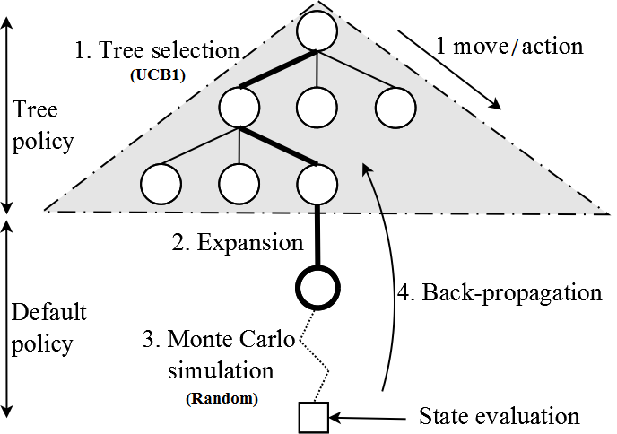
Monte Carlo Tree Search
4 Steps: Repeated iteratively during K episodes.
1. Tree selection: Following the tree policy (i.e. UCB1), navigate the tree until reaching a node with at least one child state not in the tree (this is, not all actions have been picked from that state in the tree).
2. Expansion: Add a new node in the tree, as a child of the node reached in the tree selection step.

Slide 14
Monte Carlo Tree Search
4 Steps: Repeated iteratively during K episodes.
3. Monte Carlo simulation: Following the default policy (picking actions uniformly at random), advance the state until a terminal state (game end) or a pre-defined maximum number of steps. The state at the end of the simulation is evaluated (this is, retrieve R_{T}).
4. Back-propagation: Update the values of Q(s,a), N(s) and N(s,a) of the nodes visited in the tree during steps 1 and 2.

Slide 15
Advantages of Monte Carlo Tree Search
Highly selective best-first search.
Evaluates states dynamically (not like Dynamic Programming).
Uses samples to break the curse of dimensionality.
Works in black-box models (only needs samples).
It is computationally efficient (good for real-time games).
It is anytime: it can be stopped at any value of K and return an action from the root at any moment in time.
It is parallelizable: run multiple iterations in parallel.

Slide 16
MCTS: Implementation details
Depending on your implementation, you may end up using one more than another:
Closed-loop approach: the nodes in the tree store the state reached at that position in the tree.
During the Tree Selection step, no need to call Advance. We already have the next state in the child node.
During the Expansion phase, call Copy to store the returned state on the new node.
Advance is used during the Monte Carlo Simulation.
Open loop approach: the nodes in the tree do not store the states.
At the beginning of each iteration, Copy the current state, and keep the copy until reaching the end of the Monte Carlo simulation step.
For all Tree Selection, Expansion and Monte Carlo simulation, use Advance to modify the copy of the state until the end of the simulation.
The nodes of the tree only keep the statistics (Q(s,a), N(s), N(s,a)), not the states.

Slide 17
Open versus Closed Loop Search
What is better? Depends…
Efficiency and cost of each operation.
Stochasticity: when Advance() from (s₁,a₁) does not always returns exactly the same state (i.e. imagine an element in the game that moves randomly, not under the control of the player).
In closed loop, once the state is stored, it remains unchanged.
The advance() call might have been lucky… or unlucky.
In any case, the state obtained during the expansion phase is only one of the possible states reachable at that position in the tree.
In open loop, only statistics on the nodes.
Advance is used at each step during the tree policy.
The statistics represent better the truly distribution of the states on that node.
If the game is deterministic, open loop ≡ closed loop.
If the game is stochastic, open loop is more accurate.

Slide 18
Contents
Monte Carlo Tree Search
A case study: PTSP

Slide 19
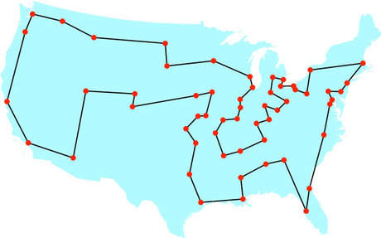
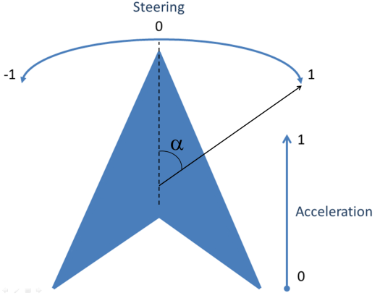
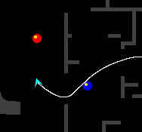
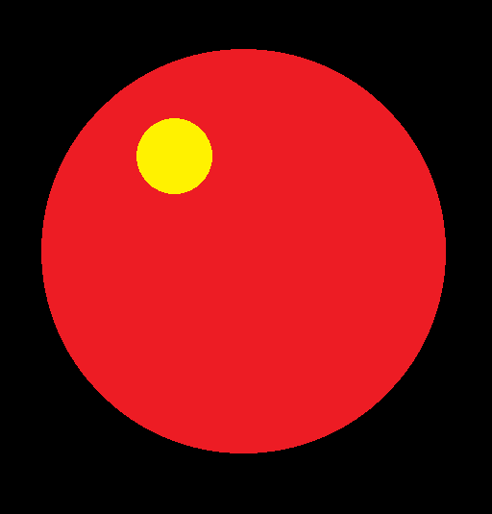

The Physical Travelling Salesman Problem
Travelling Salesman Problem:
Turn it into a real-time game!
Drive a ship.
In a maze.
With constraints:
10 waypoints to reach.
1000 steps to visit next waypoint.
40ms to decide an action.
1s initialization.

Slide 20
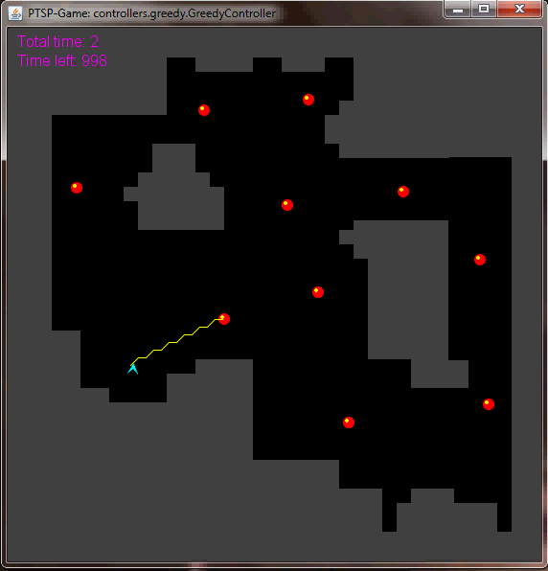
The Physical Travelling Salesman Problem
Features some aspects of modern video games:
Pathfinding.
Real-time game.
Competitions.
www.ptsp-game.net (expired)
WCCI/CIG 2012, CIG 2013
Winner: MCTS.

Slide 21
The PTSP Framework - code
The code provided (see github, in code/ptsp/*) to create controllers is divided into Java packages. These include:
controller: Controllers must be in a sub-package of this package:
Sample controllers: random.RandomController, greedy.GreedyController, lineofsight.LineOfSight and WoxController.WoxController are.
This package also contains controllers you’ll be working with today
simpleGA.GAController
mcts.MCTSController
framework. This package contains all the code for the game.
core: Core code of the game.
graph: Code for path finding.
utils: Includes useful classes.
classes ExecSync, ExecReplay, ExecFromData: Executes a controller in different execution modes.

Slide 22
The PTSP Framework - execution
framework.ExecSync.java: To execute one or several maps, with and without visuals:
Mode 1: executes several games, N times each, getting a summary of results at the end.
Mode 2: runs once in a map.
Mode 3: human-player mode.

Slide 23
The PTSP Framework – controllers
In order to create a controller for this game, the participant must write a Java class that extends framework.core.Controller. Two methods need to be implemented in this class:
A public constructor that receives a game copy (class Game).
A function called getAction(), that returns an int and receives a game copy (Game class, again) and a long variable that indicates where the controller is due to respond with an action. This function will be called every execution cycle to retrieve an action from the controller.

Slide 24
The PTSP Framework – actions
framework.core.Controller.ACTION_NO_FRONT:
No rotation and no acceleration.
This is also the action applied if no response is received within the time given.
framework.core.Controller.ACTION_NO_LEFT:
Left rotation but no acceleration.
framework.core.Controller.ACTION_NO_RIGHT:
Right rotation but no acceleration.
framework.core.Controller.ACTION_THR_FRONT:
No rotation, only forward acceleration.
framework.core.Controller.ACTION_THR_LEFT:
Left rotation and acceleration.
framework.core.Controller.ACTION_THR_RIGHT:
Right rotation and acceleration.

Slide 25
The PTSP Framework – game flow
The main class creates the game and the controller, using the appropriate constructor of this class, expecting a response in a specific time.
The main class executes the game loop, which calls the controller's method getAction() supplying a copy of the game and the time due to receive the action:
Reply in less than PTSPConstants.ACTION_TIME_MS (40ms), the action indicated is executed.
Reply after PTSPConstants.ACTION_TIME_MS and the default action (0: No acceleration and no rotation) is applied instead.

Slide 26
Requirements
A few important functions are key in the implementation of controllers with forward model:
function State Advance (State s₁, Action a₁): Takes one state s1 and an action a1, and returns the state reached after applying a₁ from s₁.
function State Copy (State s): Returns a copy of a given state.
function double Evaluate (State s): Assigns and returns a reward (r_{T}).

Slide 27
Solving the PTSP – Score function
Heuristic to guide search algorithm when choosing next moves to make.
Reward/Fitness for mid-game situations.
Components:
Distance to next waypoints in route.
State (visited/unvisited) of next waypoints.
Time spent since beginning of the game.
Collision penalization.

Slide 28
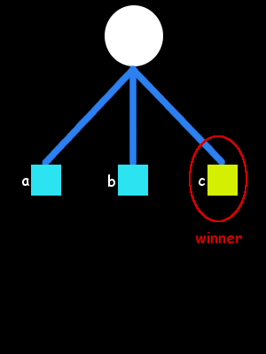
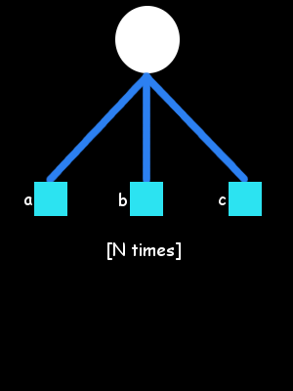
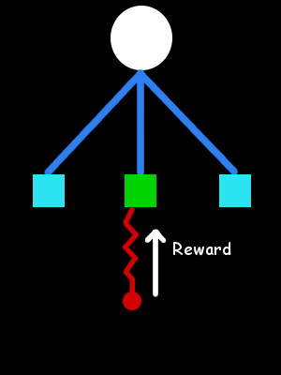
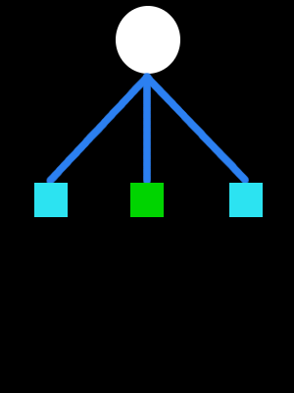
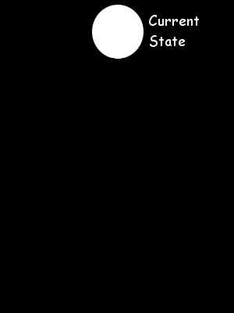
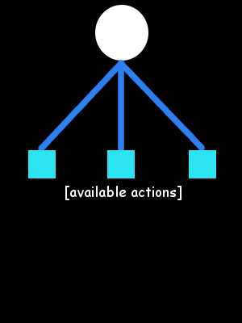
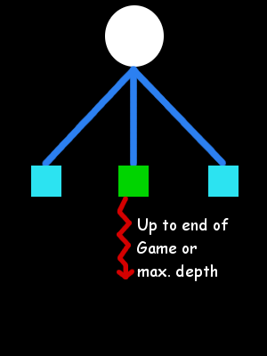
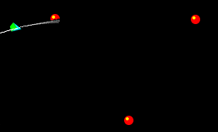
Short-term and Long-term planning
Monte Carlo (MC)
MC methods for long term planning:
Unsuitable for Long-term planning.
Terminal states not reached.

Slide 29
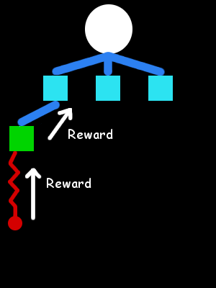
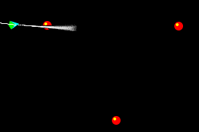
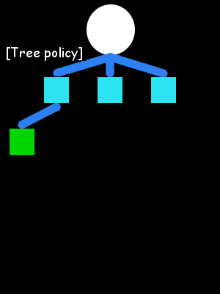
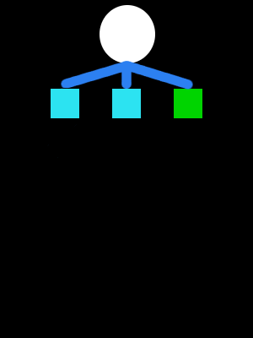
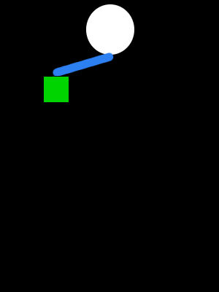
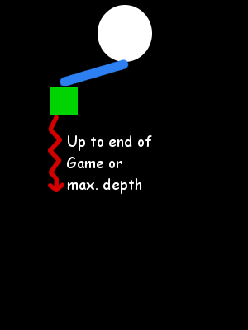
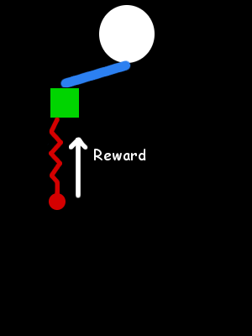
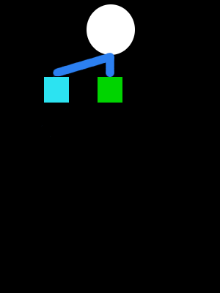
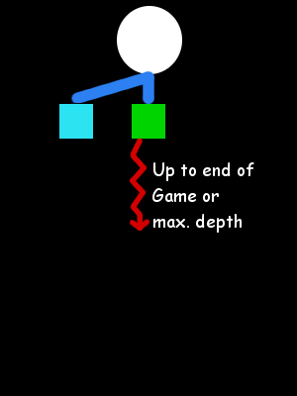

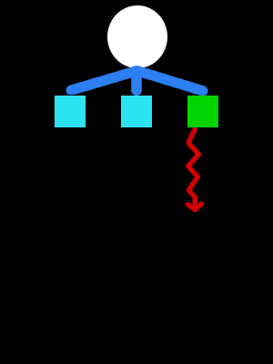
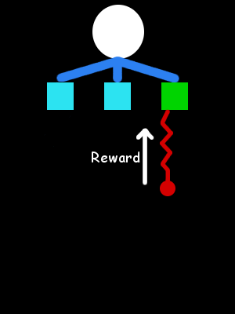
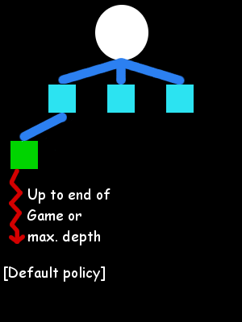
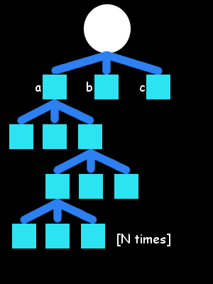
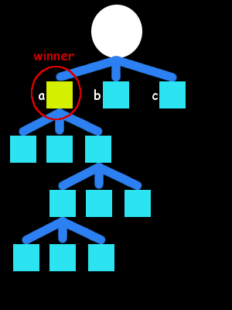
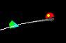
Short-term and Long-term planning
Monte Carlo Tree Search (MCTS)
Monte Carlo Tree Search:
Builds an asymmetric tree.
Further look ahead.
Even this is usually insufficient: time and search space size…

Slide 30
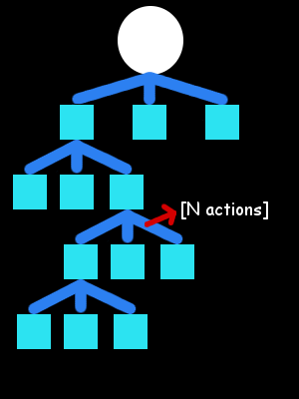
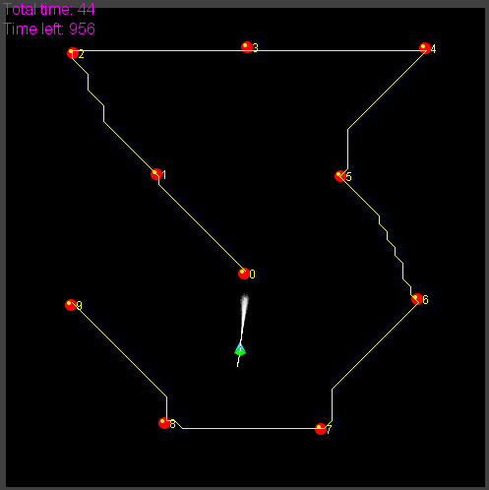
Short-term and Long-term planning
Alternative 1:
Macro-actions.
Alternative 2:
Higher-level planner.

Slide 31
Solving the PTSP – Macro-actions
Single action oriented solutions:
6 actions, 10 waypoints, 40ms to choose move.
1000-2000 actions per game.
Search space ~ 6¹⁰⁰⁰ - 6²⁰⁰⁰
Limiting look-ahead to 2 waypoints:
Assuming 100-200 actions per waypoint.
Search space ~ 6¹⁰⁰ - 6²⁰⁰
Introducing macro-actions:
Repetitions of single actions in L time steps.
Search space ~ 6¹⁰ – 6²⁰ (L=10).
Time to decide a move increased: L*40ms

Slide 32
Including the route planner
Question: Is any order better than none?
Solve TSP:
Branch and Bound algorithm.
Cost between waypoints: Euclidean distance.
Cost between waypoints: A* path cost.
Can we improve it further?
No.

Slide 33
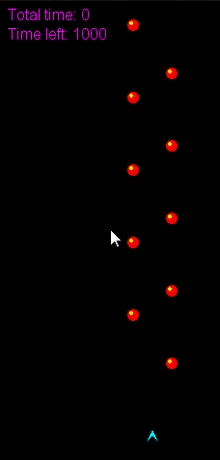
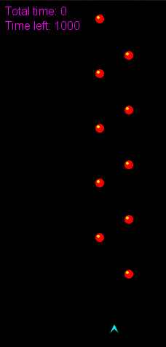
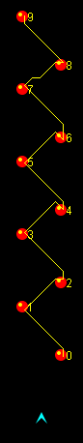
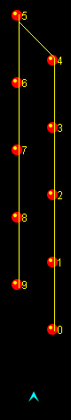
Improving the route planner

Slide 34
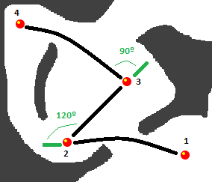
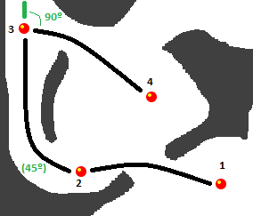
Improving the route planner
Interdependency between long- and short-term planning
Use the proper MCTS driver is prohibitively costly
Add turn angles to the cost of the paths

Slide 35
Long-term vs Short-term
Long-term vs. Short-term planning.
Tree-search limitations and long-term planning in real-time games.
PTSP
Optimal distance-based TSP solution
≠
Optimal physics-based TSP solution.
Game Level Design
Challenging maps for PTSP.
Automated Map Generation for the Physical Travelling Salesman Problem. Diego Perez, Julian Togelius, Spyridon Samothrakis, Philipp Rolhfshagen and Simon M. Lucas, in IEEE Transactions on Evolutionary Computation, 18:5, pp. 708–720, 2013.

Slide 36
Solving the PTSP – TSP Solvers

Slide 37
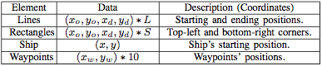
Using Agents for Game (Level) Design
Search space: possible maps for the PTSP
Each map is represented by an array of floating point values (L lines, S rectangles):
Problem: Feasibility of maps. All waypoints must be reachable from the ship’s initial location. Some maps (individuals) are infeasible and must be discarded (or given a very low fitness).
Evolutionary Algorithm: CMA-ES.

Slide 38
Using Agents for Game (Level) Design
Simulation-based evaluation function: We use three PTSP controllers to evaluate the maps being evolved. Each controller calculated and followed a different route:
Nearest-first TSP (N_{TSP}): The order of waypoints is obtained by applying the nearest first algorithm to solve the TSP.
Distance TSP (D_{TSP}): The distance between two points is calculated using A*, and the route using the Branch and Bound (B&B) algorithm (regular TSP algorithm).
Physics TSP (P_{TSP}): B&B is used to find the route, but the distance between two points is affected by physical parameters such as the expected speed and orientation of the ship at that point.

Slide 39
Using Agents for Game (Level) Design
The maps evolved should have the following property:
The time to complete a map by N_{TSP} must be longer than D_{TSP}, that must be also longer than P_{TSP}
N_{TSP} > D_{TSP} > P_{TSP}
We can model a fitness function that maximizes
N_{TSP} - D_{TSP}, D_{TSP} - P_{TSP}
(or minimizes the negation of that).

Slide 40
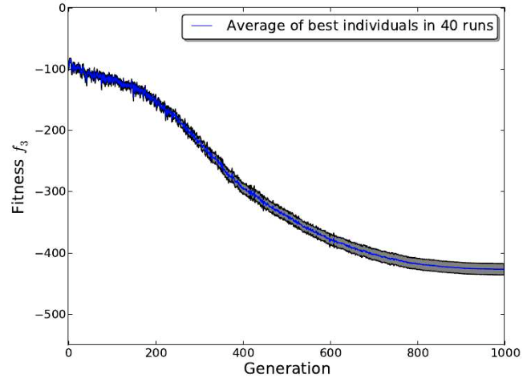
Using Agents for Game (Level) Design

Slide 41
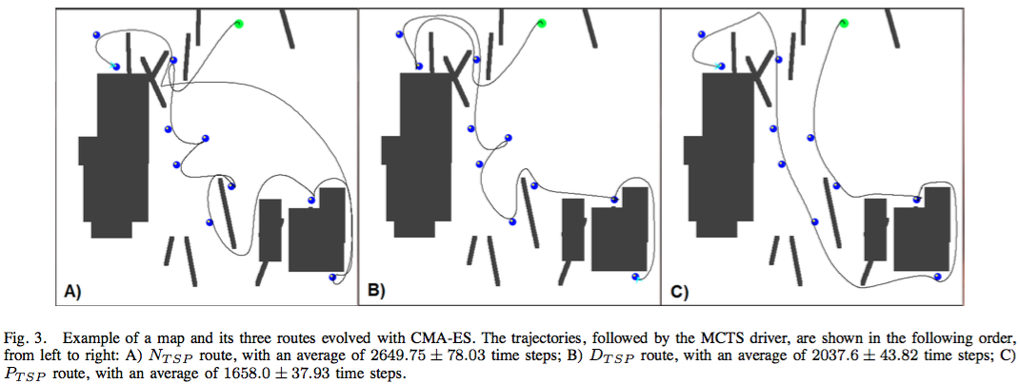
Using Agents for Game (Level) Design

Slide 42
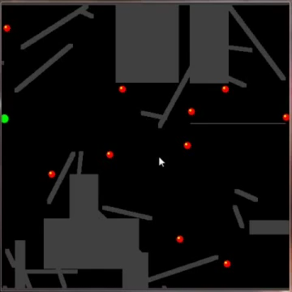
Using Agents for Game (Level) Design

Slide 43
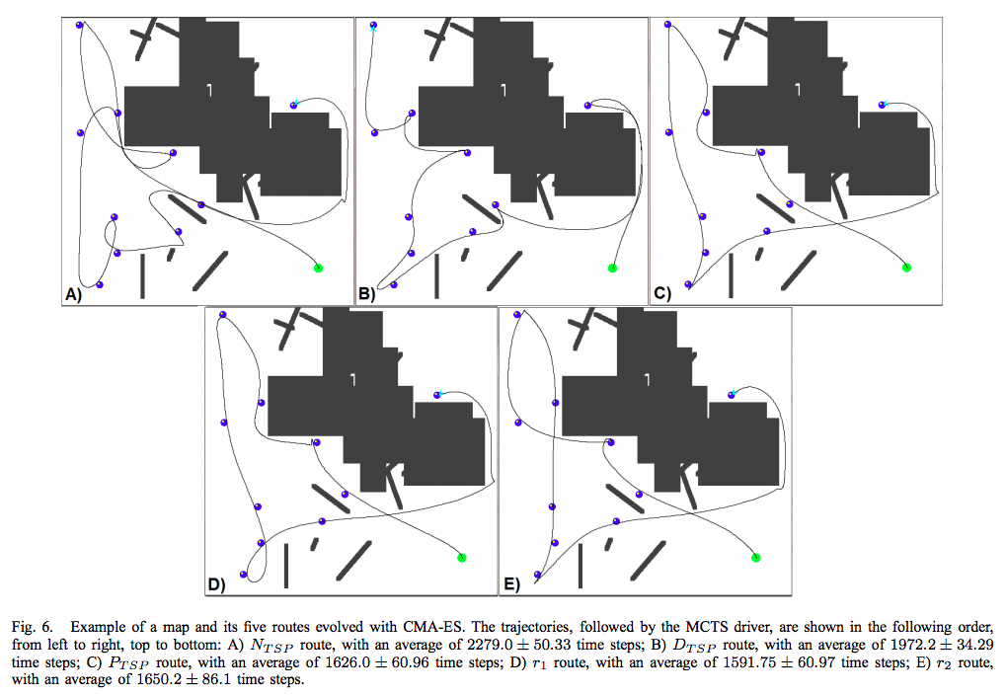
Using Agents for Game (Level) Design

Slide 44
Optional Exercise
Have a look at the PTSP code (any subfolder):
Have a look at the MCTS Controller (controllers.mcts.MCTSController).
Tune:
The parameters of the MCTS Controller (depth, macro-action length, C, etc. – MCTS.java)
The score/value function (GameEvaluator.score)
Can you make it better?
There is also a RHEA controller (controllers.simpleGA.GAController) that you can play with

